Slide 1
LiDAR

Slide 2

LiDAR – Light Detection and Ranging

Slide 3
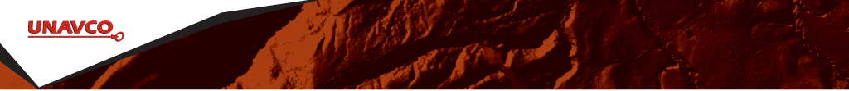
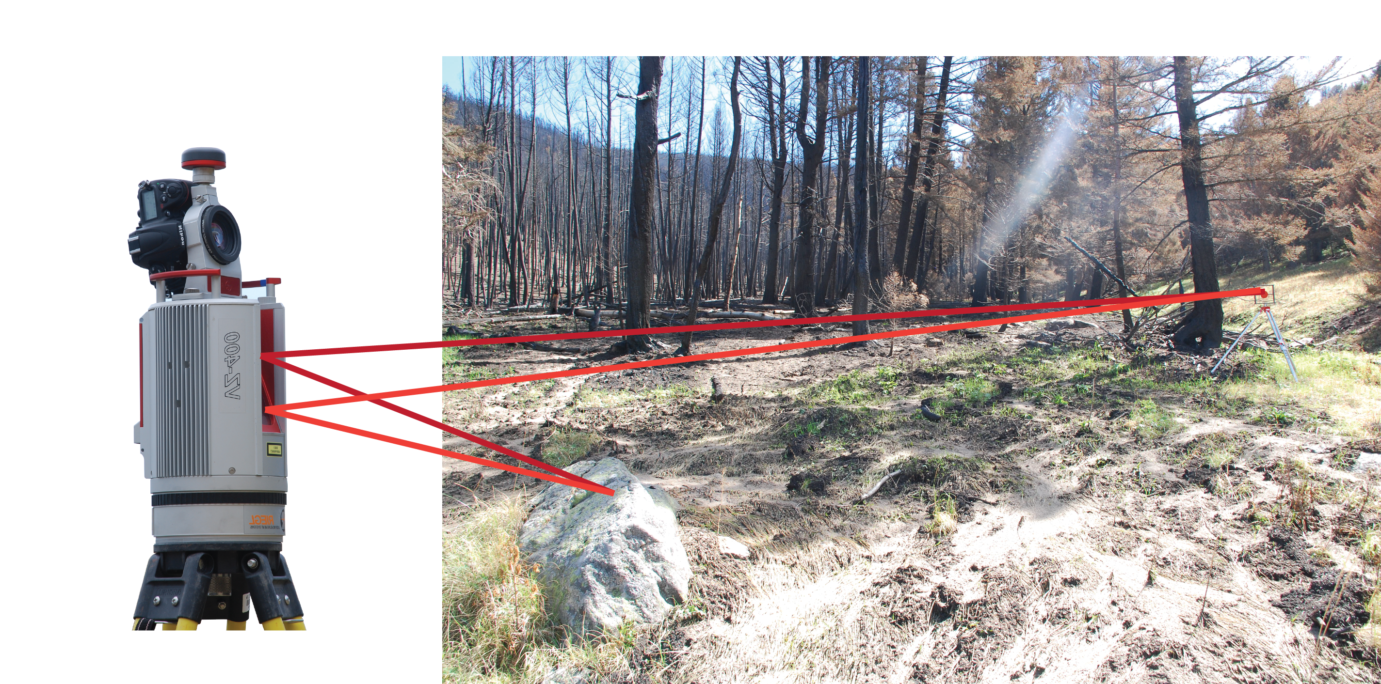
Light Detection and Ranging (lidar)
Accurate distance measurements with a laser rangefinder
Distance is calculated by measuring the two-way travel time of a laser pulse.
Near IR (1550nm) or green (532nm)
Photo Bruce Douglas
Notes:
Light detection and ranging or lidar works by measuring the distance between a scanner and any object in its field of view by emitting a laser pulse and measuring the time it takes to return and be recorded by a receiver.

Slide 4
How is range measured?
Time of flight
Time it takes for emitted pulse to reflect off object and return to scanner.
Phase shift
By measuring the phase shift of a pulse, distance is calculated along a sinusoidally modulated laser pulse.
Notes:
There are two ways that this range between the object and the scanner is measured. The first is time of flight, which is what the Riegl scanner you’ll use utilizes. the calculated time is based on the time it takes a signal to be returned. Phase shift measures the phase shift of a pulse and uses that to calculate the distance.

Slide 5
Advantages and disadvantages
Time of flight
Range ~ 100–6000m
Accuracy ~ 1 mm
< 300,000 pts/s
Slower, larger
Phase shift
Range ~ 0–100m
Accuracy ~ 1 micron
> 1,000,000 pts/s
Noise in data
Notes:
Advantages exist for both systems. Time of flight has a larger maximum range, which means it can be used in sites where the area of interest may or may not be directly accessible. Phase shift is more accurate and can collect more points per second. Time of flight is a slower and larger system, whereas phase shift data can be noisy and only collected when one is close to the feature of interest.

Slide 6
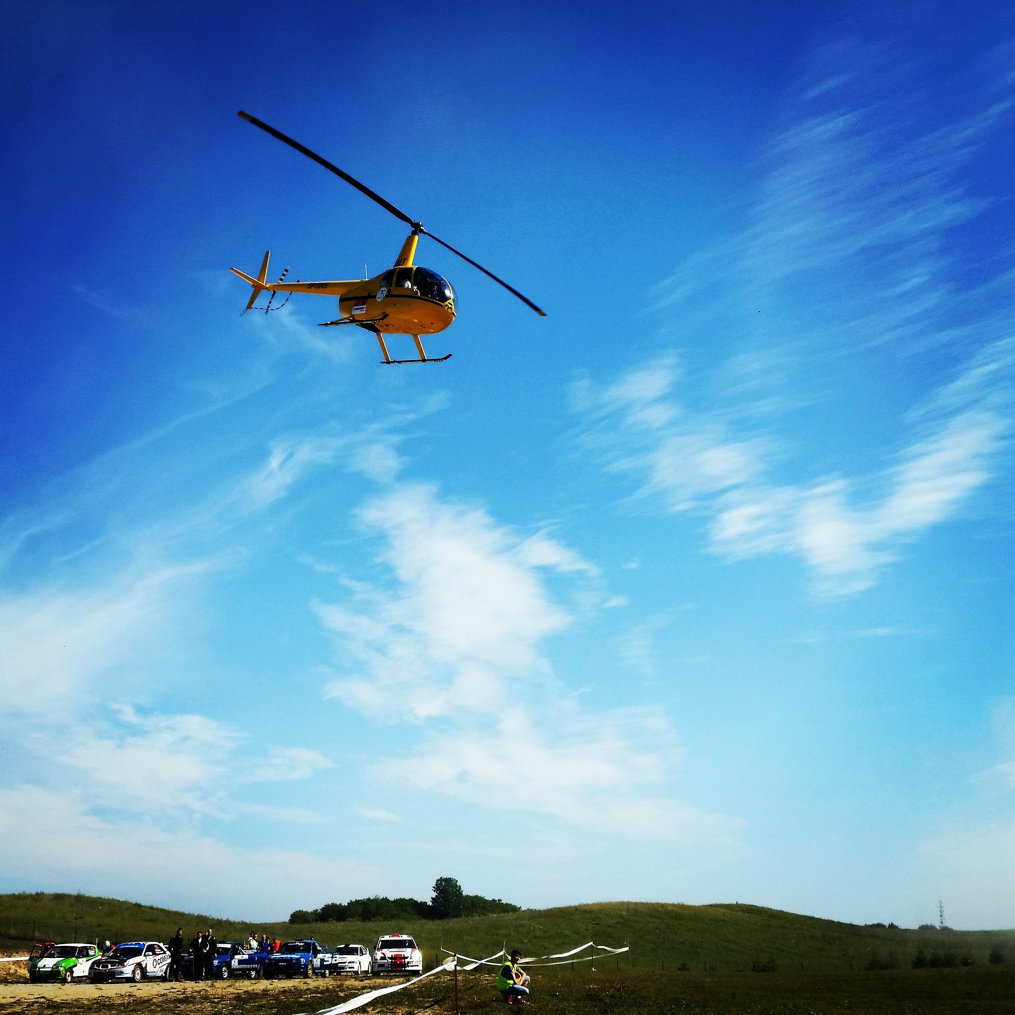
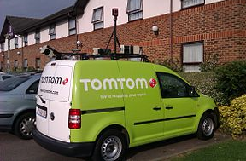
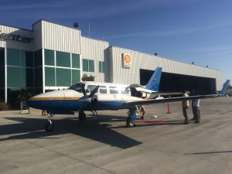
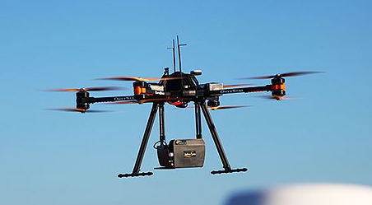
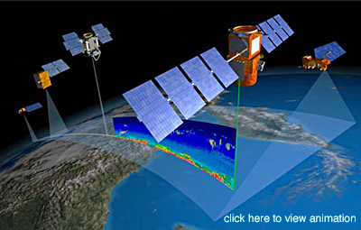
A Suite of Lidar Platforms
NASA
Notes:
Lidar data can be collected using many platforms: tripod (what you learn in this module), drone, helicopter, airborne, satellite, and even off the top of a car.
Images (clockwise from upper left):
https://pixabay.com/static/uploads/photo/2015/11/11/23/31/sky-1039395__180.jpg (CC)
http://www.opentopography.org/blog/opentopography-rides-along-airborne-lidar-survey-ncalmhttp://www.opentopography.org/sites/opentopography.org/files/images/news_items/plane_thumb.jpg (public domain)
https://en.wikipedia.org/wiki/Lidar#/media/File:Mapping_van_tomtom_with_five_lidars.jpg (public domain)
http://www.hq.nasa.gov/office/hqlibrary/documents/o55480866.pdf (public domain)
By Cargyrak - Own work, CC BY-SA 4.0, https://commons.wikimedia.org/w/index.php?curid=48685015 (CC)

Slide 7
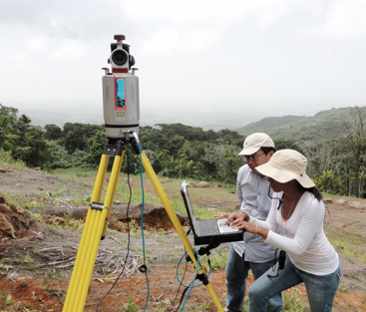
Light Detection and Ranging (lidar)
Similar technology, different platforms:
Terrestrial Laser Scanning (TLS)
- Also called ground based lidar or T-lidar.
Laser scanning moving ground based platform = Mobile Laser Scanning (MLS).
Laser scanning from airborne platform = Airborne Laser Scanning (ALS).
Notes:
Read slide. Don’t need to spend a lot of time on this one!
Images: UNAVCO and https://en.wikipedia.org/wiki/Lidar#/media/File:Mapping_van_tomtom_with_five_lidars.jpg

Slide 8
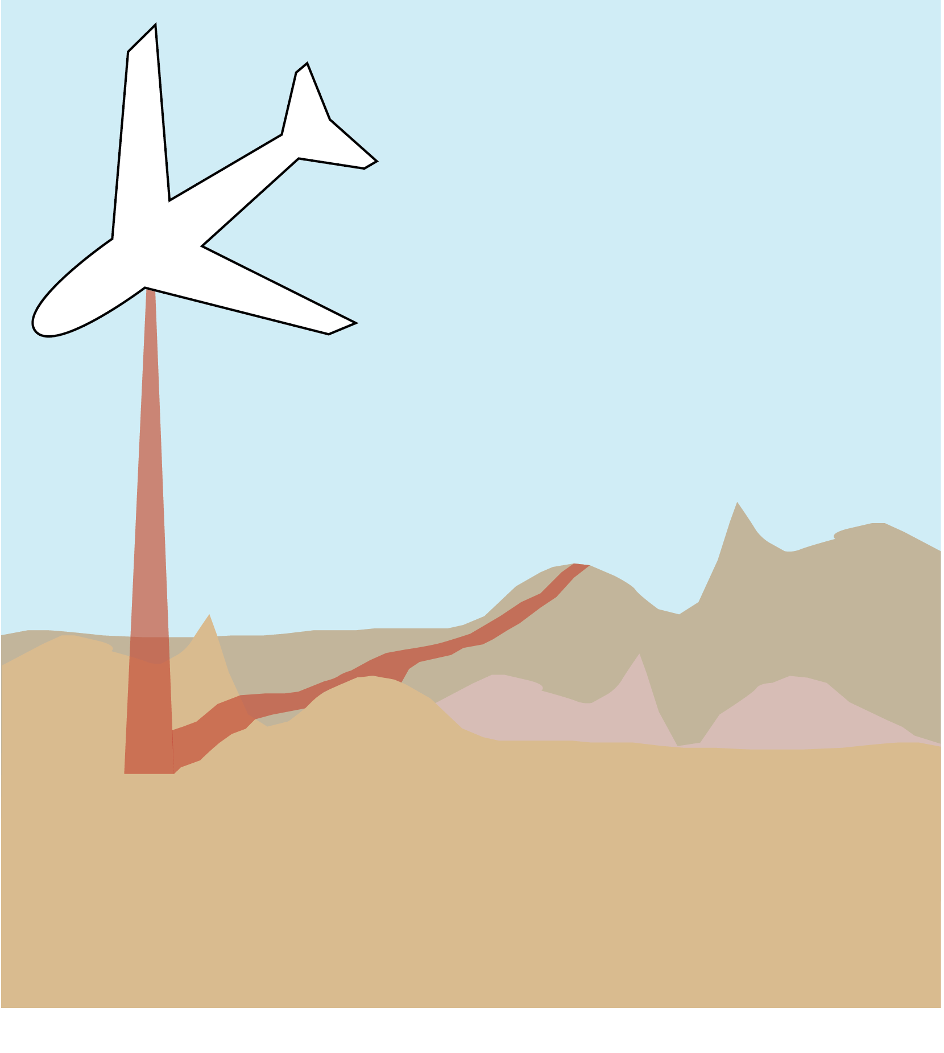
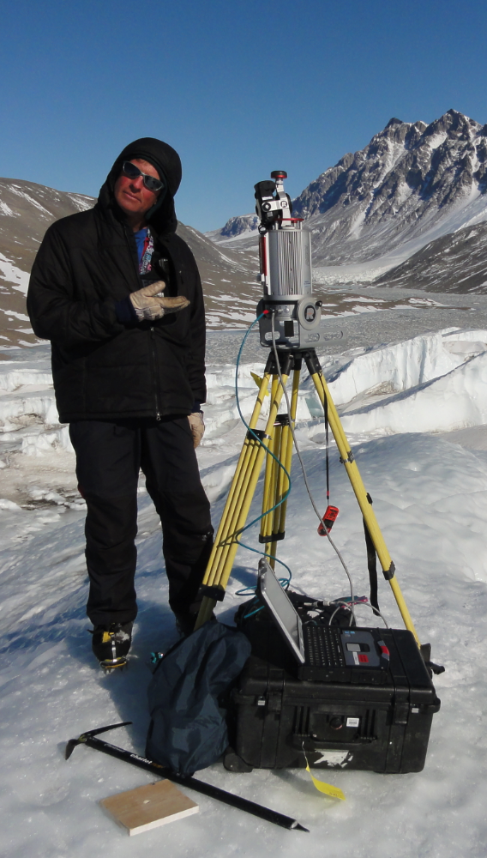
Light Detection and Ranging (lidar)
System: | Spaceborne (e.g. GLAS) | High Altitude (e.g. LVIS) | Airborne (ALS) | Terrestrial (TLS)
Altitude: | 600 km | 10 km | 1 km | 1 m
Footprint: | 60 m | 15 m | 25 cm | 1–10 cm
Vertical Accuracy | 15cm to 10m depends on slope | 50/100 cm bare ground/ vegetation | 20 cm | 1–10 cm Depends on range, which is few meters to 2 km or more
GLAS/ICESAT
Notes:
Because of all these different platforms, we can collect data using lidar over a huge range of scales.
Images NASA public domain

Slide 9
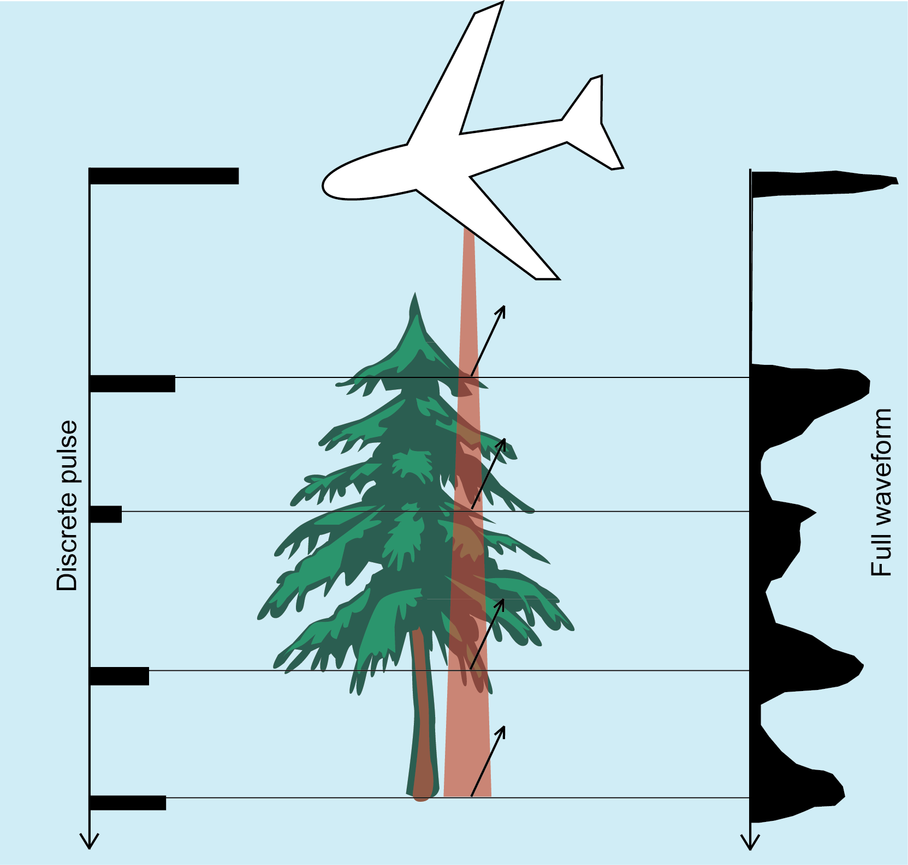
Discrete pulse and full waveform
Discrete pulse = binary yes- or-no return
Full waveform = digitized backscatter waveform
Benefits of full waveform?
More resolution between pulse width ambiguity
Spectral property information
Improved fitting of geometrically defined targets.
Notes:
The vast majority of scanners are discrete pulse
Lidar can record data in one of two ways: discrete pulse or full waveform. Full waveform is preferred because it has better resolution and fits targets better, but discrete pulse can be used for a lower resolution scan. This also depends on the scanner being used.
Image: Kate Shervais

Slide 10
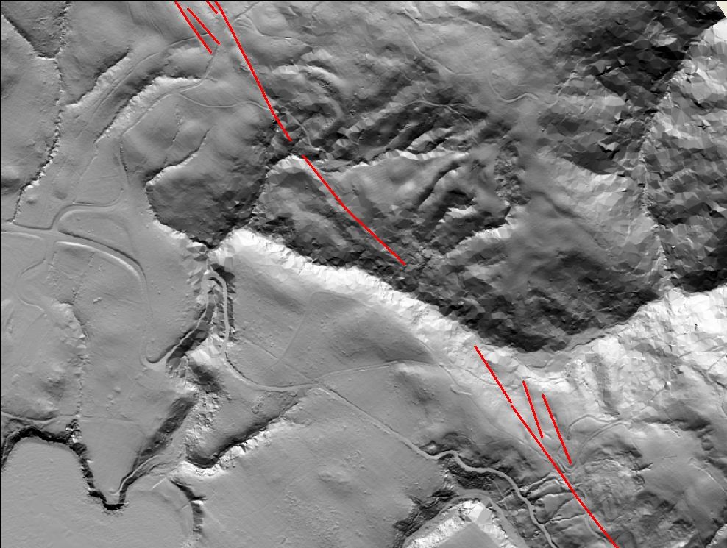
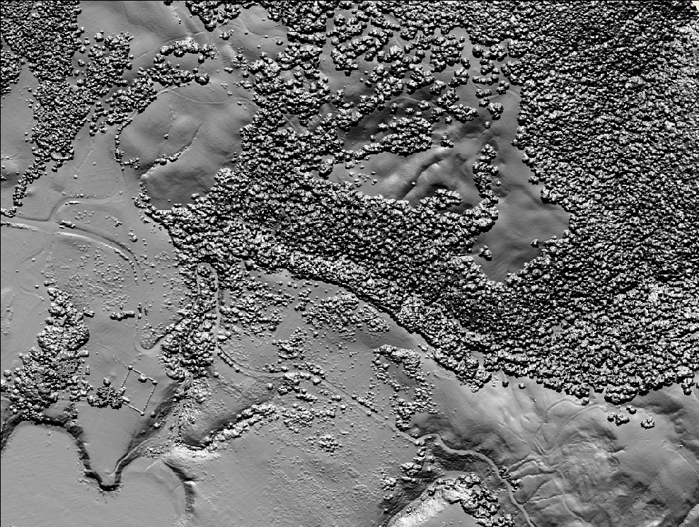
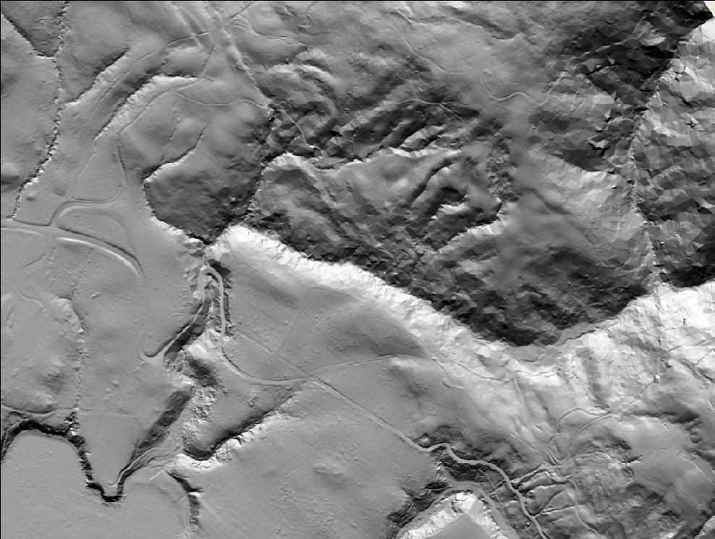
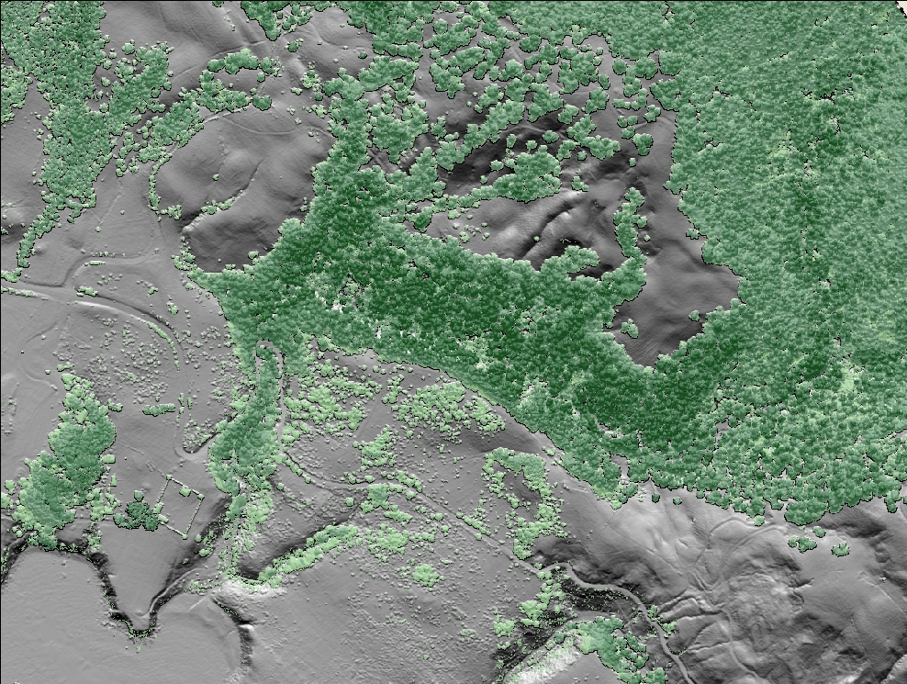
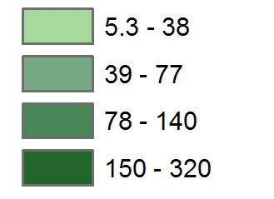
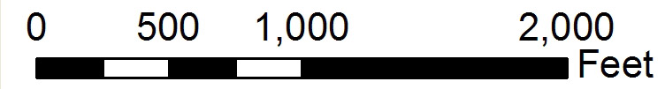
Canopy Height (ft)
Notes:
In geoscience, we are very interested in the topography of the earth but not always so interested in the vegetation. (space bar) When you use lidar in general you are able to actually de-vegetate the view because of the multiple returns we just discussed. This is Highway 1 and Fort Ross in California. Red line is the rupture of the 1906 earthquake, as mapped in the 1906 official report on the earthquake. What geologists tend to think of as noise (vegetation) may be something someone else could be very interested in. So you could also analyze the height of the vegetation (space bar).

Slide 11
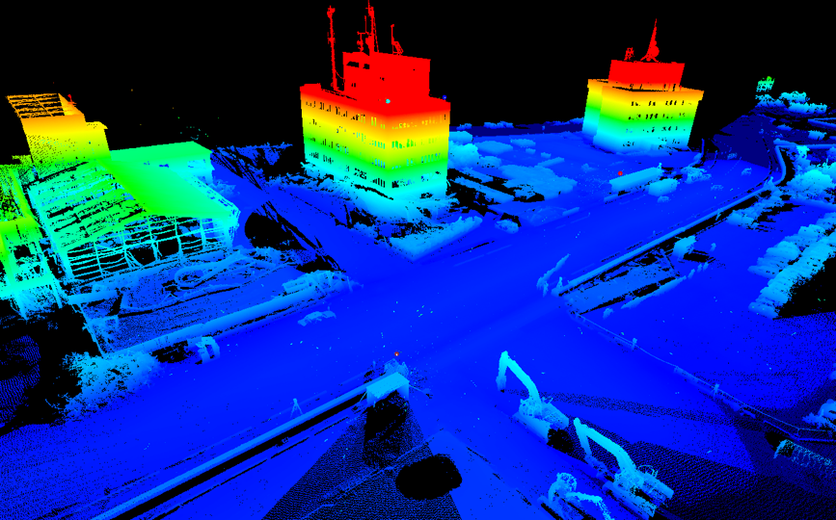
2011 Japan Tsunami
Notes:
While this slide shows the resultant scan, projected using the elevation of the data.
Images: UNAVCO

Slide 12
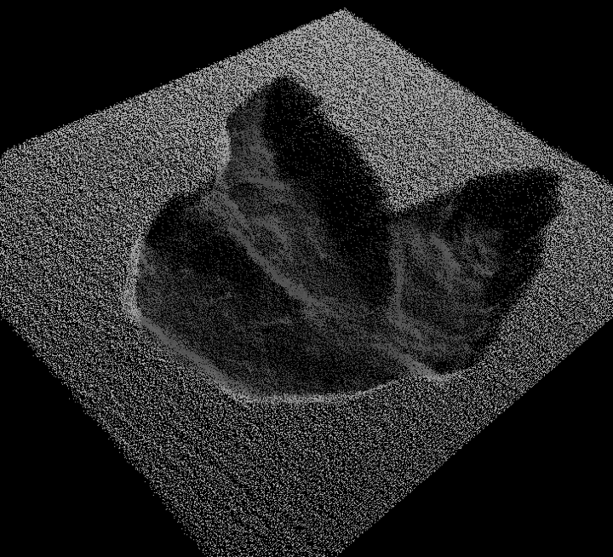
Dinosaur Trackway, Fiorello
Notes:
In non-polar settings, Lidar has been used to record dinosaur footprints.
Images: UNAVCO

